Slide 1




Data Structure project
Roz Alzehari 2210051
Raghad Najmuldeen 2210302

Slide 2
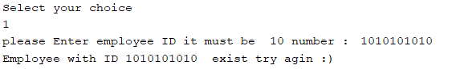
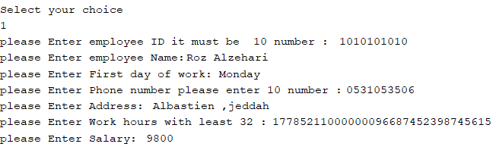
insert employee
This operation allows you to add a new employee to the system. The user will enter the employee's details such as name, ID, position, and salary, and the system will store this information in the data structure if user enter 1 also it will show if we have already the same id

Slide 3
insertion sort algorthim
//insertion sort algorithm
while (temp.next != null && ID > temp.next.ID) {
temp = temp.next;
}
if (head == temp) {
new_node.next = head;
head = new_node;
} else {
new_node.next = temp.next;
temp.next = new_node;
}}
implements the insertion sort algorithm for a linked list of employee records based on their ID values.It iterates through the list and finds the correct position to insert a new employee record based on its ID. The code then updates the pointers to insert the new record at the appropriate location. This process ensures that the linked list remains sorted in ascending order by ID.

Slide 4
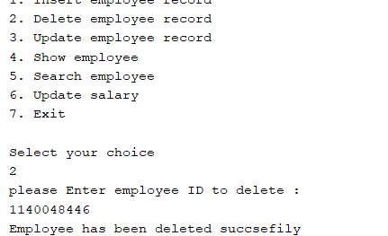
Delete employee record
With this operation, you can remove an employee's record from the system. The user will provide the ID or any other identifier of the employee to be deleted, and the program will find and remove that employee's record from the data structure.

Slide 5
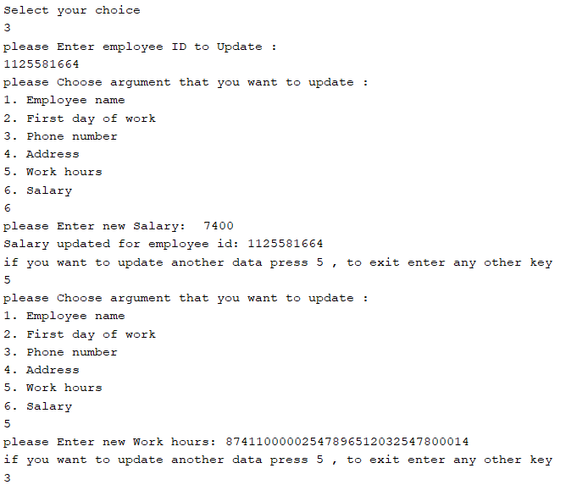
Update employee record:
This operation enables you to modify the information of an existing employee. The user will input the ID or any other identifier of the employee to be updated, and then the program will allow the user to modify fields such as name, position, or salary for that employee.

Slide 6
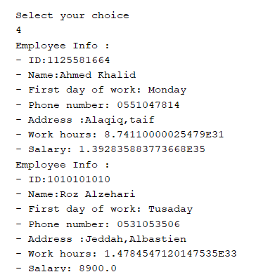
show employee record:
: This operation displays the details of all employees currently stored in the data structure. It will retrieve and present the employee records, including their names, IDs, positions, and salaries.

Slide 7
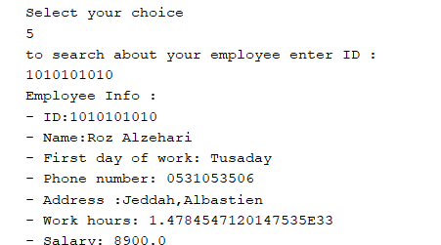
search employee record:
This operation allows you to search for a specific employee based on their ID or other identifier. The user will input the search criteria, and the program will find and display the employee's record if it exists in the data structure.

Slide 8
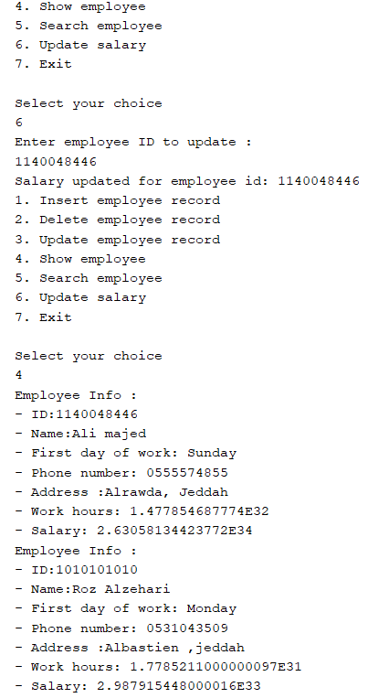
update employee salery:
This operation enables you to change the salary of a particular employee. The user will provide the employee's ID or other identifier, and then the program will allow the user to update the salary field for that employee.

Slide 9
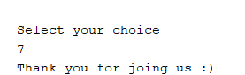
Exit program

Slide 10
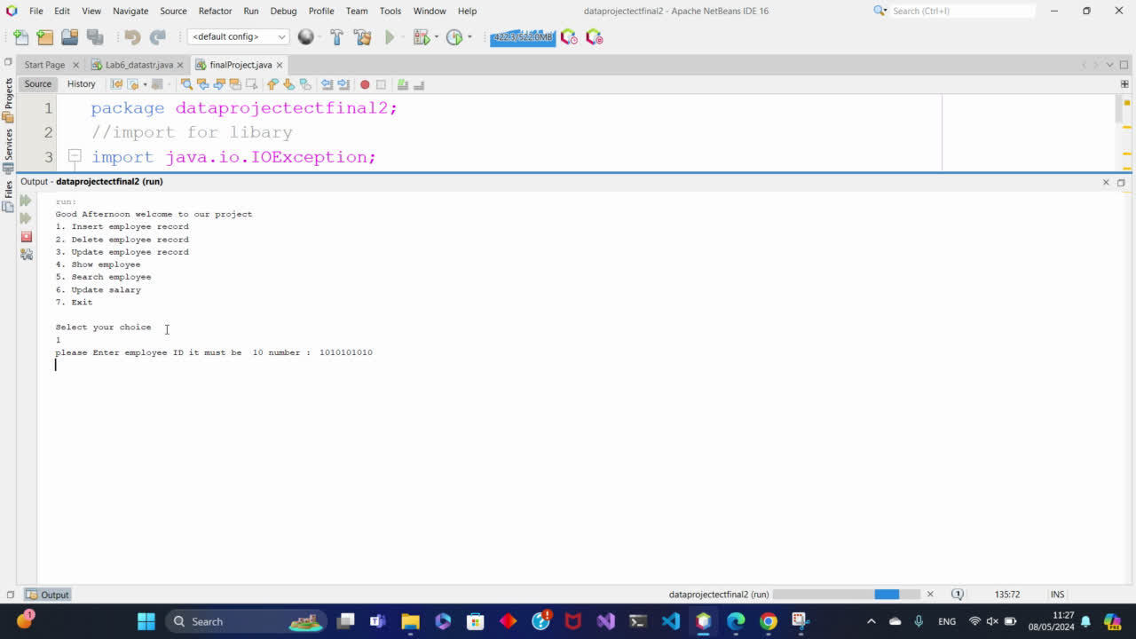

And this a vedio show process

Slide 11
Thank you for your time

Slide 12
Reffrence :
[1]https://www.geeksforgeeks.org/insertion-sort/
[2]https://www.javatpoint.com/singly-linked-list
[3]https://www.programiz.com/java-programming/examples/linkedlist-implementation

